Slide 1
The Diffie-Hellman Algorithm
Shital Girme 25/08/2018

Slide 2
Contents
Introduction
Implementation
Example
Applications
Diffie-Hellman Key Exchange Algorithm

Slide 3
Introduction
Discovered by Whitfield Diffie and Martin Hellman
  “New Directions in Cryptography”, 1975
Diffie-Hellman key agreement protocol
  Exponential key agreement
  Allows two users to exchange a secret key
  Requires no prior secrets
  Real-time over an untrusted network
Diffie-Hellman Key Exchange Algorithm

Slide 4
Introduction (Continued…)
Security of transmission is critical for many network and Internet applications
Requires users to share information in a way that others can’t decipher the flow of information
  “It is insufficient to protect ourselves with laws; we need to protect ourselves with mathematics.”
  -Bruce Schneier (American cryptographer)
Diffie-Hellman Key Exchange Algorithm

Slide 5
Introduction (Continued…)
Based on the difficulty of computing discrete logarithms of large numbers.
No known successful attack strategies
Requires two large numbers,
  one prime (p), and
  A number (g) - primitive root of p
Diffie-Hellman Key Exchange Algorithm

Slide 6
Implementation
p and g are both publicly available numbers
  p is at least 512 bits
Users pick private values a and b
Compute public values
  x = gª mod p
  y = g^{b} mod p
Public values x and y are exchanged
Diffie-Hellman Key Exchange Algorithm

Slide 7
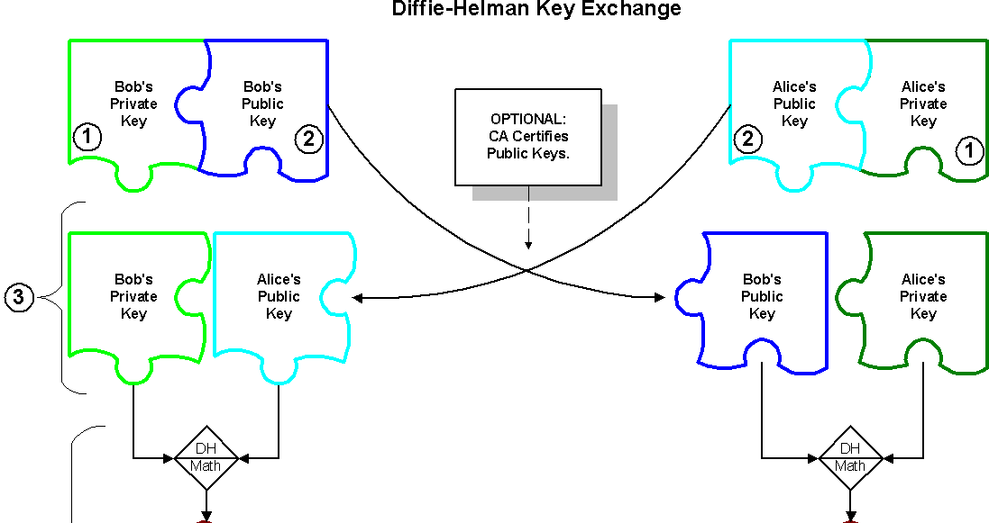
Implementation (Continued…)
Copyright, 2001 by NetIP, Inc. and Keith Palmgren, CISSP.
Diffie-Hellman Key Exchange Algorithm

Slide 8
Implementation (Continued…)
Compute shared, private key
  k_{a} = yª mod p
  k_{b} = x^{b} mod p
Algebraically it can be shown that k_{a} = k_{b}
  Users now have a symmetric secret key to encrypt
Diffie-Hellman Key Exchange Algorithm

Slide 9
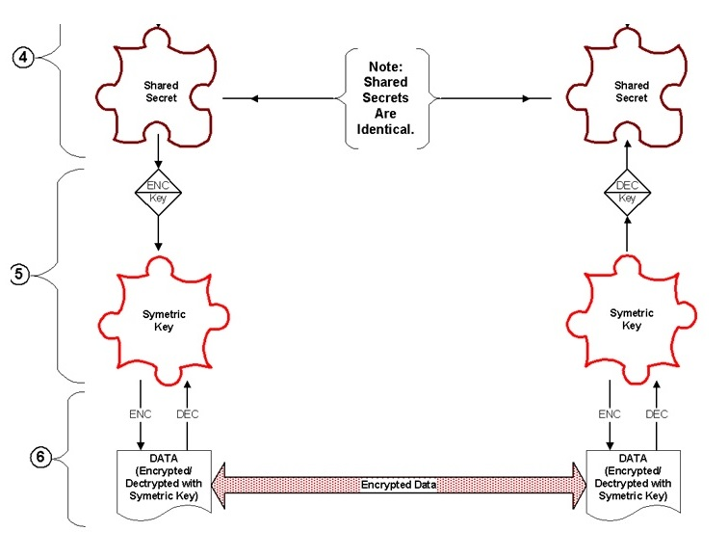
Implementation (Continued…)
Copyright, 2001 by NetIP, Inc. and Keith Palmgren, CISSP.
Diffie-Hellman Key Exchange Algorithm

Slide 10
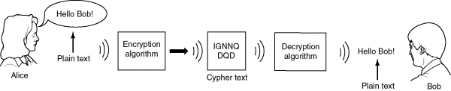
Example
Two Internet users, Alice and Bob wish to have a secure conversation.
They decide to use the Diffie-Hellman protocol
Diffie-Hellman Key Exchange Algorithm

Slide 11



Bob and Alice are unable to talk on the untrusted network.
  Who knows who’s listening?
Diffie-Hellman Key Exchange Algorithm

Slide 12
Alice and Bob get public numbers
  p = 23, g = 9
Alice and Bob compute public values
  X = 9⁴ mod 23 = 6561 mod 23 = 6
  Y = 9³ mod 23 = 729 mod 23 = 16
Alice and Bob exchange public numbers
Diffie-Hellman Key Exchange Algorithm

Slide 13
Alice and Bob compute symmetric keys
  k_{a} = yª mod p = 16⁴ mod 23 = 9
  k_{b} = x^{b} mod p = 6³ mod 23 = 9
Alice and Bob now can talk securely!
Diffie-Hellman Key Exchange Algorithm

Slide 14
Applications
Diffie-Hellman is currently used in many protocols, namely:
  Secure Sockets Layer (SSL)/Transport Layer Security (TLS)
  Secure Shell (SSH)
  Internet Protocol Security (IPSec)
  Public Key Infrastructure (PKI)
Diffie-Hellman Key Exchange Algorithm

